Slide 1

MONITORING, EVALUATION AND REPORTING (MER) FOR CLIMATE ACTION PLANNING
Summary & Introduction
Supported by:

Slide 2



How to use the slide deck (for facilitators only)
2
The following slides were produced to support city advisers (and city officials) initiate conversations regarding Climate Action Plan (CAP) Monitoring, Evaluation and Reporting (MER) in their cities, while presenting the resources available.
The slide deck includes an introduction & overview section to highlight the importance of setting out a method for monitoring, evaluation, reporting and revision of the CAP; which resources C40 provides to support the process; and a proposed approach for developing an MER system (including good practice examples from other cities). In the ‘process for developing an MER system’ section, the reader will find a proposed step-by-step approach following the structure of the City CAP Monitoring, Evaluation and Reporting Guidance. For each of the steps, the user will find three components (each one identified by a logo):
A very brief summary of each section/step
The available resources that could be useful to support that step of the process (references and access links available in the Guidance document)
A good practice city example
Users can tailor the slide deck to their needs by changing the case studies and following a different order for the proposed step-by-step approach. Users can also find callout notes, including some recommendations that can be removed.
www.c40knowledgehub.org

Slide 3

Contents
3
INTRODUCTION AND OVERVIEW
Climate action planning: from vision to actions
What is an MER system & why to include one?
Benefits of an MER system
CAP Framework criteria
MER RESOURCES
Available resources to support the city CAP MER system
Guidance
Indicators Matrix & User Guide
Workshop Material
3. PROCESS FOR DEVELOPING AN MER SYSTEM
Governance & Structure
Intervention Logic
Define Indicators
Monitoring
Evaluation
Reporting
4. CITY EXAMPLES
www.c40knowledgehub.org

Slide 4
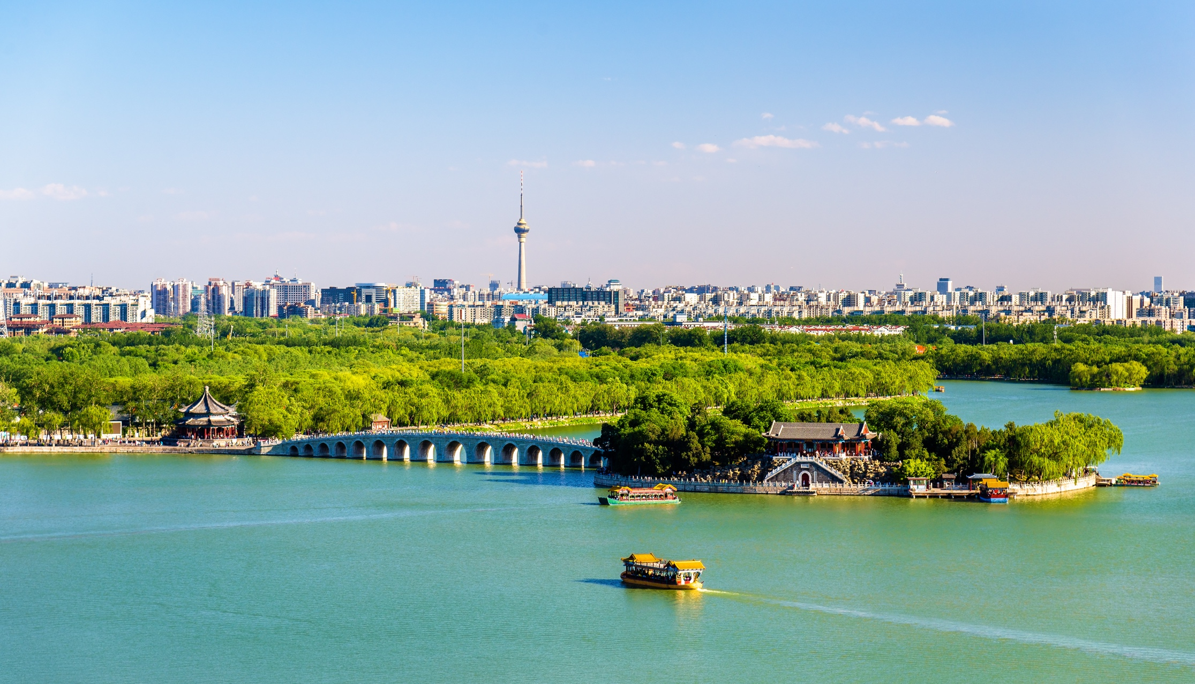
INTRODUCTION AND OVERVIEW
4

Slide 5
Climate Action Planning – Vision, strategies & actions
5
The objective of the CAP is to set a pathway to a carbon neutral, resilient and inclusive city. The Climate Action Plan (CAP) is a strategic document - or set of documents – showing how a city will deliver on its commitment. A city CAP MER system allows to show progress while reaching the final targets.
Vision: long-term qualitative thinking that says what your city want to become. Answers the why question.
Strategy: starts with a vision - an idea of what to work towards. The strategy is the technology or system changes needed to achieve the vision. A good strategy meets your need and context, all contribute to defining what will be practical and effective for your city, setting checkpoints and milestones along the way. The strategy made your vision more tangible, but it doesn’t have enough details for implementation.
Action: policy, programme, or investments to fulfil the strategy.
The vision lays out a destination that guides the strategy which chooses the action. It’s the action that leads to success!
www.c40knowledgehub.org

Slide 6
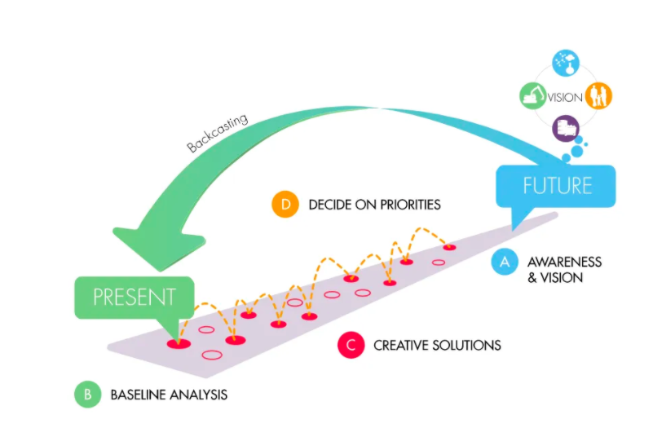
From vision to strategy
6
Reading the diagram in line with the steps and stages of the CAP process:
Define the vision
Build the evidence base
Identify strategies
Identify and prioritise actions
Prioritise actions
Define the vision
Identify strategies
Build the evidence base
Adapted from the Natural step:
https://thenaturalstep.org/approach/
www.c40knowledgehub.org

Slide 7
City Examples
7
Cities are choosing different ways to track performance of their actions linked to their desired vision. Please see in the following slides, a few examples showing how cities are setting overarching targets, defining priority actions; organizing them under particular action lines/pillars and define indicators to help organise the MER approach. Cities are:
Setting the vision and the corresponding short, medium and long term targets to achieve the city´s vision.
Defining the main areas/pillars/strategic priorities/lines of actions; under which the actions can be organized.
Identifying priority actions to meet those targets and make a clear connection of how these will achieve the identified benefits, targets, milestones; highlighting main outcomes and overall impacts.
Identifying how to review and report progress of the implementation plan.
Defining the type of indicators that the city will use to measure progress, in line with previously identified evaluation criteria
Suggest start the conversation understanding your City´s vision, targets and priorities
www.c40knowledgehub.org

Slide 8
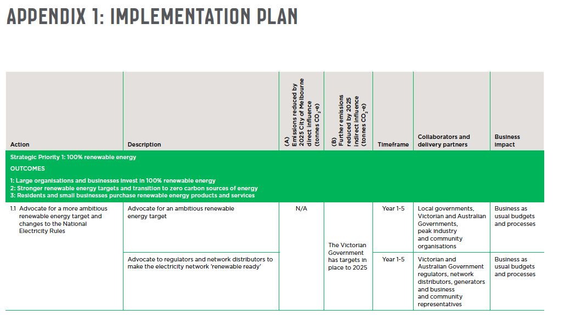
Melbourne
8
City of Melbourne
Presents actions by strategic priorities, highlighting main outcomes.
Progress will be reviewed each year to adjust the five-year rolling Implementation Plan
During implementation of actions, the Council will consider the Policy Objectives and Guiding Principles in accordance the Climate Change Act 2017
Climate Change Mitigation strategy. Melbourne together for 1.5
www.c40knowledgehub.org

Slide 9
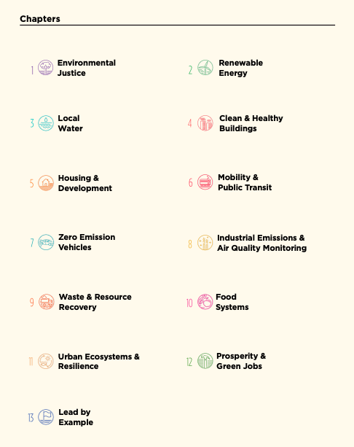
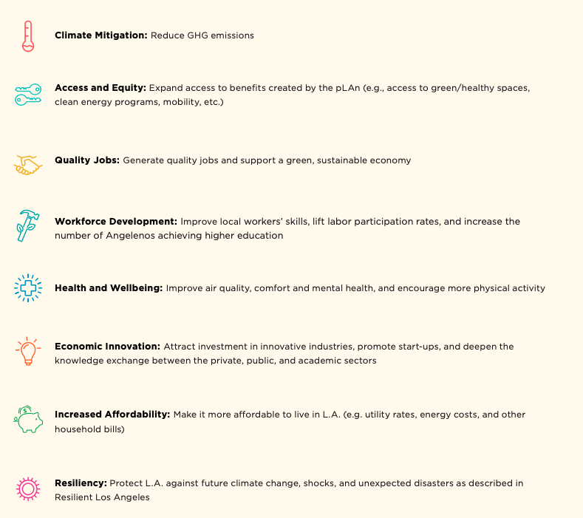
Los Angeles
9
Each chapter is assessed on how much it can achieve the following benefits.
LA structures the plan in 13 topic chapters
LA´s Green New Deal
www.c40knowledgehub.org

Slide 10
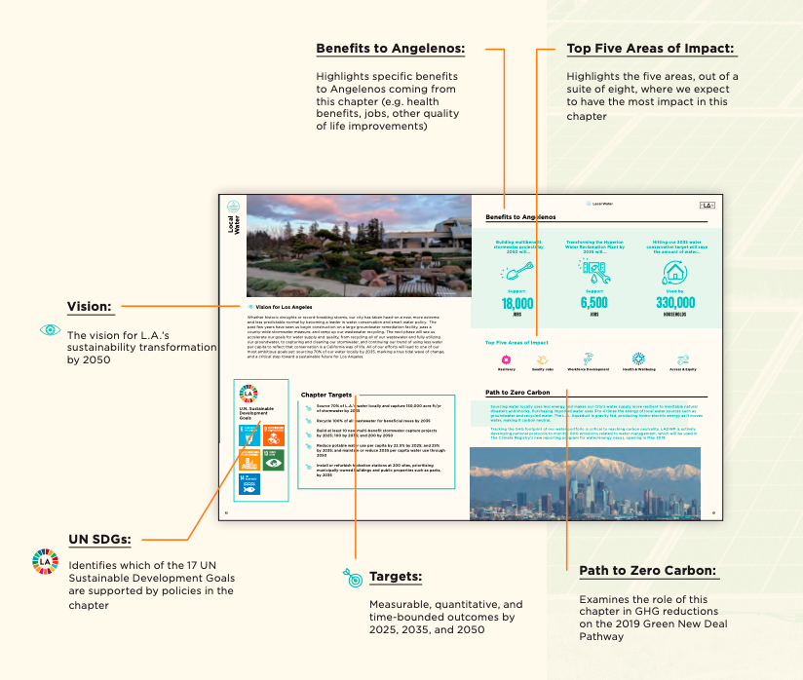
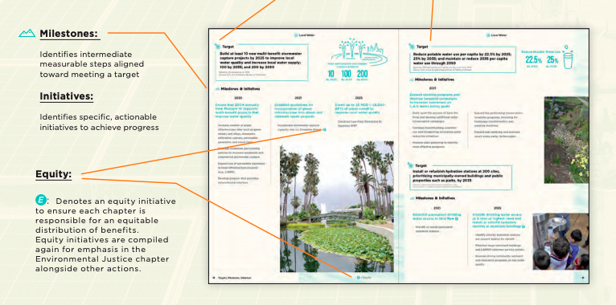
Los Angeles
10
Chapter Layout for L.A.’s Green New Deal
www.c40knowledgehub.org

Slide 11
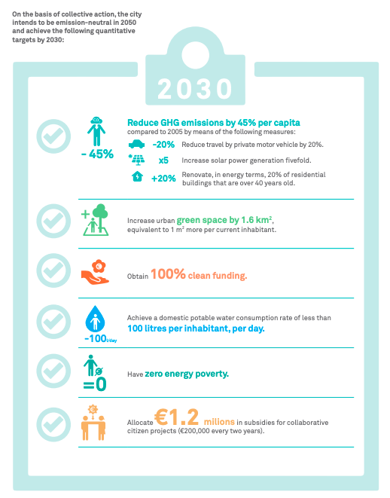
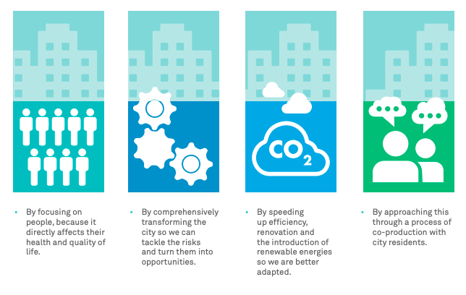
Barcelona
11
Principles behind the plan. Barcelona´s plan is based on 4 strategic lines : mitigation, adaptation & resilience, climate justice and promoting citizen action.
Barcelona Climate Action Plan 2018-2030
Strategic goals and targets
www.c40knowledgehub.org

Slide 12

Barcelona
12
Barcelona will measure progress against the following indicators:
Impact
Action
Resource
Environmental
Perception
Performance
Plan has 5 areas and 18 lines of action
www.c40knowledgehub.org

Slide 13
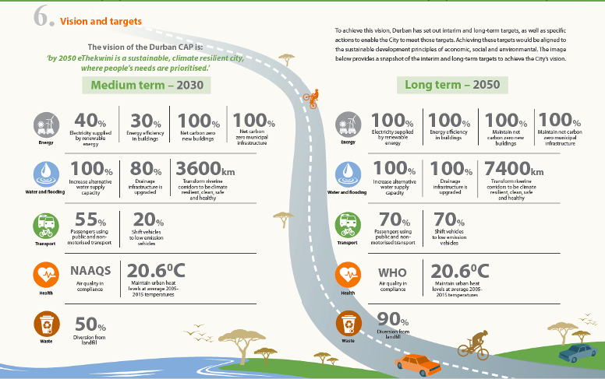
Durban
13
Durban Climate Action Plan 2019
www.c40knowledgehub.org

Slide 14
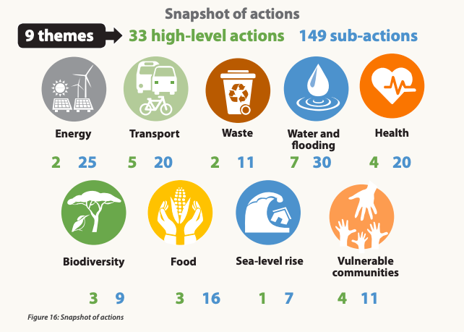
Durban
14
Monitoring & Evaluation framework
The city will focus on the following areas and indicators:
Strategy & direction
Learning and communication
Governance & management
City will develop follow up indicators that can include: Overall performance indicators; Impact indicators; Resource indicators; Environmental indicators; Incident indicators.
A monitoring report will be completed every two years through the development of a State of Climate Change Report.
www.c40knowledgehub.org

Slide 15
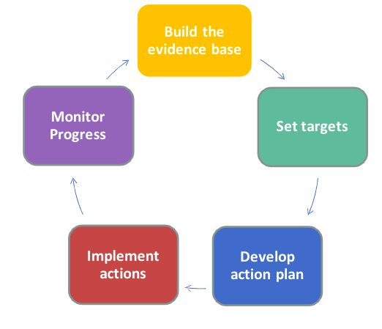
What is an MER system & why to include one?
15
The objective of the Climate Action Plan (CAP) is to set a pathway to a carbon neutral, resilient and inclusive city. The content of the CAP is a set of targets, with strategies and prioritised actions to focus on achieving those targets​. It’s an iterative process, where steps are repeated with the aim of achieving continuous improvement (see figure)
A Monitoring, Evaluation and Reporting (MER) system enables cities to decide what is important to measure, how to measure it and how to assess the real progress against the CAP targets, demonstrating the value of the actions taken. It also allows cities to show short-term progress, while reaching the final targets may take a considerable amount of time.
www.c40knowledgehub.org

Slide 16
Benefits of an MER system
16
In order to measure success and adjust priorities over time, cities are looking to develop a well-structured system to monitor, evaluate and report progress. This is essential for monitoring the effects of climate actions across a diverse range of stakeholders.
1
SHARING
Provide relevant information to a wide range of stakeholders
2
GROWING
Continue to make the case for other possible climate actions
A CAP MER system enables cities to track and review the intended results and real progress, which could lead to greater access to national and international climate funding and secure more support from key stakeholder groups.
3
PERFORMING Assess progress and effectiveness and adapt actions and plans accordingly
4
COMMUNICATING
Improve transparency and accountability
www.c40knowledgehub.org

Slide 17


CAP FRAMEWORK CRITERIA
17
PLAN COMPILATION
3.4 MONITORING, EVALUATION, REPORTING AND REVISION
In line with the CAP Framework criteria, cities should develop a Monitoring, Evaluation and Reporting system as part of the Plan Compilation section of their Climate Action Plan.
Long-term commitment to delivering the plan should be demonstrated through a process of setting key performance indicators, ongoing monitoring, impact evaluation and progress reporting. This will provide stakeholders with transparency about the process, inspiring trust in the city government and its commitment to becoming an emissions neutral and climate resilient city by 2050. The plan should set out a method for monitoring, evaluation, reporting and revision.
www.c40knowledgehub.org

Slide 18
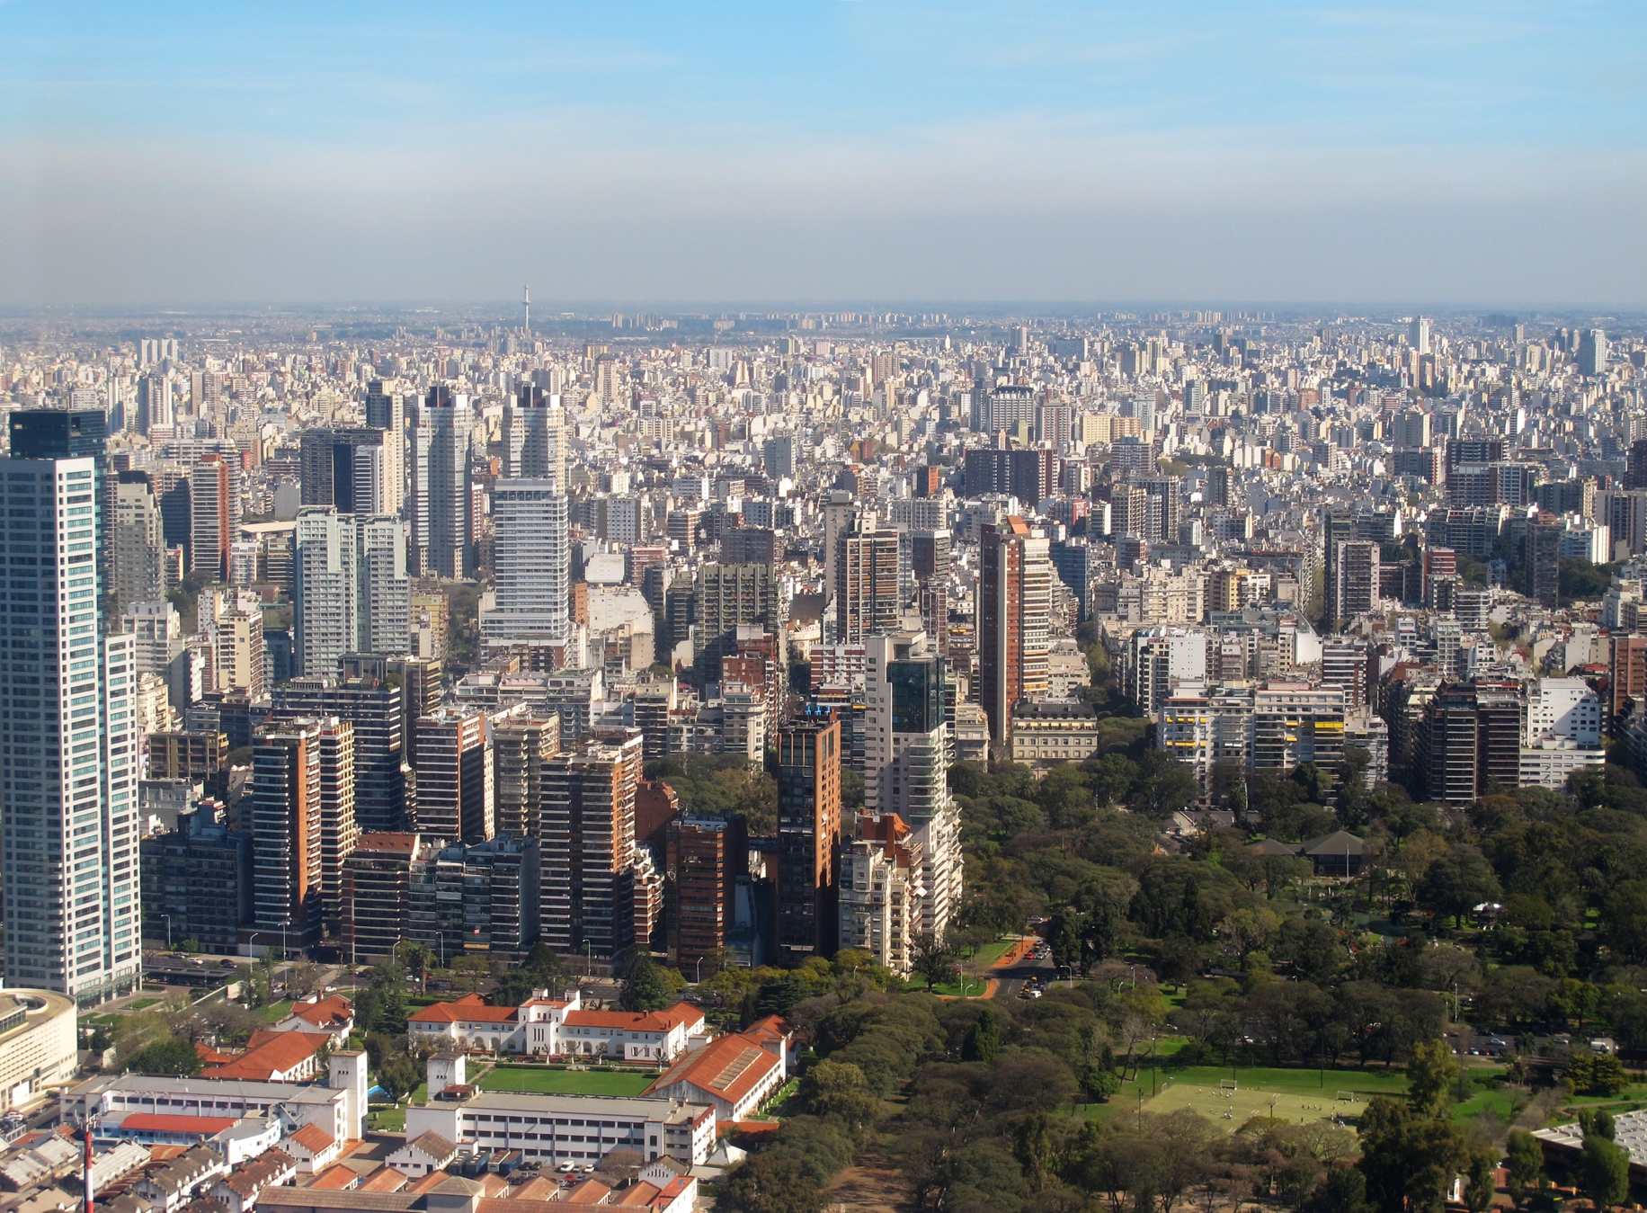
MER RESOURCES
18

Slide 19
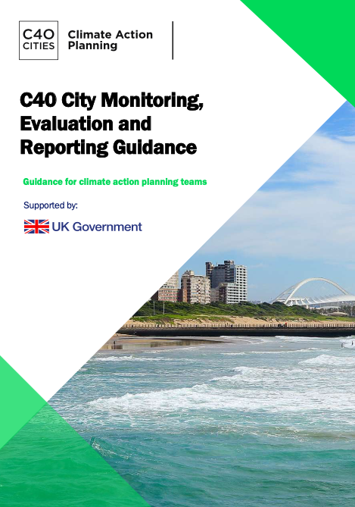
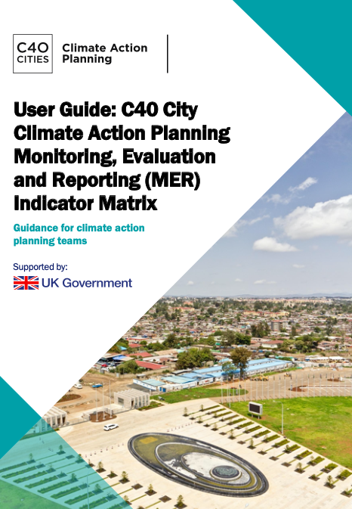

19
Available resources to support the city CAP MER system
City CAP MER Guidance
Indicator Matrix & User Guide
Workshop/Meeting
Material
Designed to support teams responsible for building MER indicators
Result chain intervention logic indicators for 106 actions
Matrix User Guide to summarize and better understand how to use the database
City CAP MER introductory slide deck
Proposed materials to support initial conversations with the city (proposed agenda, sessions dynamic and activities)
Designed to support cities develop and implement effective CAP MER systems
Step-by-step approach
Includes city examples (Example Annex)
www.c40knowledgehub.org
centre.c40.org

Slide 20
Guidance
20
The guidance is structured in 5 sections, following a six steps approach to develop an MER system. It includes city examples and high-level guidance on data collection and good quality principles.
5 Sections:
Purpose of this guidance
What is a City CAP MER system?
City CAP MER Governance
How to develop a CAP MER System in your city
Conclusion
2 Annexes
Glossary + References
Please note that the guidance includes references to other resources
Available in C40 Knowledge Hub
centre.c40.org
www.c40knowledgehub.org

Slide 21
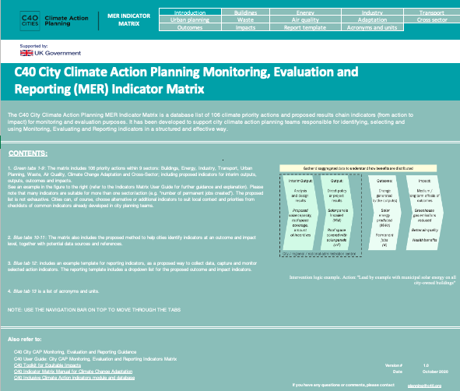
Indicators Matrix & User Guide
21
The matrix includes proposed indicators for 106 climate actions, following the result chain intervention logic (see further explanation in slide 18), organized in 9 sectors: Buildings, Energy, Industry, Transport, Urban Planning, Waste, Air Quality, Climate Change Adaptation and Cross-Sector.
It also provides guidance on outcome and impact indicator definitions and methods, and an example report template for collecting and reporting data.
The User Guide provides the recommended steps to help set up and start using the City CAP MER actions and indicators, presenting a worked example and a proposed report template. The User Guide also presents the complete list of actions included in the matrix.
Available in C40 Knowledge Hub
www.c40knowledgehub.org
centre.c40.org

Slide 22

Workshop/Meeting Material
22
City CAP MER introductory slide deck: developed to support the first meeting with the core city team to introduce the MER work.
Following the step-by-step approach, proposed materials will be developed to support initial conversations (steps 1 to 3) to:
be able to understand and assess current monitoring systems;
identify gaps (if any) and opportunities to strengthen current processes;
identify current & new indicators.
Note: new materials will be coming soon and presented in a different slide deck
Materials will include a proposed agenda, aims and sessions dynamic & proposed team activities for the meetings.
www.c40knowledgehub.org

Slide 23

PROCESS FOR DEVELOPING AN MER SYSTEM
23

Slide 24
Process for developing an MER system
24
Cities may already have monitoring systems in place to track progress on the city’s /mayor’s priority actions. The purpose and scope of the MER should be defined early on and key stakeholders for developing it should be identified.
The purpose is usually to measure the outcomes and impact of the Climate Action Plan (CAP,) to inform the review and update of actions, and ensure the effective and efficient allocation of resources to deliver the CAP and benefits to the city.
The scope is typically monitoring, evaluation and reporting of the CAP with focused evaluation of key transformational/flagship policies.
The proposed steps are described in the guidance document, in sections 3 and 4, and are accompanied by a proposed checklist of key activities for each, to support the city in developing a robust MER system.
www.c40knowledgehub.org

Slide 25
Process for developing an MER system
25
The process for developing an MER system can be done in a step-by-step approach, with a high-level of flexibility. The next slides follow these proposed steps (as presented in the guidance) but the user can tailor the order and the content to their own context. Please note the following are recommended steps and suggested good practice tips.
Governance & Structure
Intervention
Logic
Define Indicators
Monitoring
Evaluation
Reporting
T
To ensure MER is integrated into climate planning & implementation
Needed chain of results leading from action to impact
To provide evidence of change to measure achievement
Continuous, systematic collection of data
Process to assess and understand changes
Present data & analysis to stakeholders
Establish the MER system governance, engaging different stakeholders
Identify specific indicators to measure actual results at a stage level
Develop indicators methodologies & identify sources. Add inclusive indicators
Define what data the city needs
& who will regularly provide that data
Conduct periodically, tracking the actions to improve their impact
Identify the main audiences
& what information do they need/provide
www.c40knowledgehub.org

Slide 26



Governance & Structure
26
Step
Summary
Resources
City
Example
Establish a coordination team, define roles & responsibilities, engage different stakeholders
Define a reporting strategy (possible to do this at the end, depending on each context)
Agree resources and budget needed to implement the CAP MER system.
City CAP Monitoring, Evaluation and Reporting Guidance
C40 Mayors Agenda for a Green and Just Recovery
Vertically Integrated Action Tool (VIA Tool)
CAP Governance Self-Assessment
Feel free to change the example. More options in slide 34
Washington DC set out specific governance tasks which included an annual “Budget Challenge” competition for the district government to start the Sustainable DC Initiative and enable practical action to be taken with a wide range of stakeholders
www.c40knowledgehub.org
www.resourcecentre.c40.org

Slide 27
Intervention logic
27
Step
Summary
Resources
City
Example
Develop intervention logic for priority climate actions
Identify and regularly review critical assumptions made to ensure that the process is realistic
Barcelona focuses on defining categories of indicators to monitor outcomes. These are designed according to the following criteria: relevance; data availability; sensitivity to change; completeness; ease of interpretation; and comparability. Six categories are defined:
Impact; Action; Resource; Environment; Perception & Performance
Note: this example from BCN is not part of the guidance. Also check Adaptation MER framework for more examples
City CAP Monitoring, Evaluation and Reporting Guidance
City CAP MER Matrix User Guide
Measuring progress in Urban Climate Change Adaptation MER Framework
www.c40knowledgehub.org

Slide 28
Establish Intervention Logic: from action to impact
28
By measuring the whole chain of results, in a step-wise, logical way, risks of non-implementation can be identified early, and the assumptions made can be tested and revised.
Action: Any policy, program, project or activity initiated by urban public officials with the intention of contributing to climate resilience, carbon neutrality & inclusivity.
Milestones: major events, dates, decisions, or deliverables, usually in a project plan that might be used to monitor progress.
Output: Improvement from baseline, produced by the action.
Outcome: Change generated by the output. Not under direct control of the action intervention.
Impact: Effect of the outcome.
www.c40knowledgehub.org

Slide 29
Define Indicators
29
Step
Summary
Resources
City
Example
Toolkit for Equitable Impacts
Road Map for Inclusive Planning
Inclusivity for Community Engagement Playbook
Adaptation MER action matrix
ICA indicators database
Copenhagen used the C40 Benefits of Building Energy Retrofits Analysis Tool to assess the economic benefits of a deep retrofit pilot project in municipal school buildings, and to make the case for scaling-up action. The city found that expanding the retrofit to 40 schools would save USD 1.1 million in energy costs and create around 274 full-time jobs.
Select Indicators for measuring progress on all targets, in coordination with city departments.
Develop indicator methods and identify sources
Agree processes and selection of inclusive indicators
Feel free to change the example. More options in slides 35, 36 & 37
www.c40knowledgehub.org

Slide 30
Monitoring
30
Step
Summary
Resources
City
Example
For the Helsinki 2035 Action Plan, the open decision - making policy involves the openness of data and participation, meaning that all data will be available to all interested parties and interested groups are constantly encouraged to participate. The City Council provides an annual overview of the progress of the Action Plan, including progress on emissions and action implementation
Develop and regularly update the city GHG inventory and the Climate Risk Assessment
Establish data quality controls
Complete a data needs assessment
Feel free to change the example. More options in slides 38 & 39
C40 Cities Climate Data Management Framework
Maturity Assessment Tool
C40 Benefits Tool
Indicator Matrix
www.c40knowledgehub.org

Slide 31
Evaluation
31
Step
Summary
Resources
City
Example
Define purposes, types and timing of evaluations to be done
Check evaluation findings can be implemented
Select realistic research questions according to evaluation purpose
Melbourne developed a measurement & evaluation plan to accompany their climate action strategy:
Self-assessment once per year with a comprehensive evaluation after five years
Collaborate with stakeholders
Publicly report emissions inventory each year
City CAP Monitoring, Evaluation and Reporting Guidance
OECD, Better Criteria for Better Evaluation Revised Evaluation Criteria Definitions and Principles for Use
Feel free to change the example. More options in slide 40
www.resourcecentre.c40.org
www.c40knowledgehub.org

Slide 32
Reporting
32
Step
Summary
Resources
City
Example
Draft reporting plan, including resources, audiences, timings and report formats.
Prepare standard reporting tools and templates
Revise reporting plan while incorporating user feedback
City CAP Monitoring, Evaluation and Reporting Guidance
City CAP MER Matrix User Guide
Measuring progress in Urban Climate Change Adaptation MER Framework
In 2014 Mexico City Government started a Monitoring System of Mexico City’s Climate Action Program through which government agencies report progress on their actions. The system enables the development of reports for every climate action by city agencies or priority axis. Reported progress is publicly available online.
Feel free to change the example. More options in slide 41
www.resourcecentre.c40.org
www.c40knowledgehub.org

Slide 33
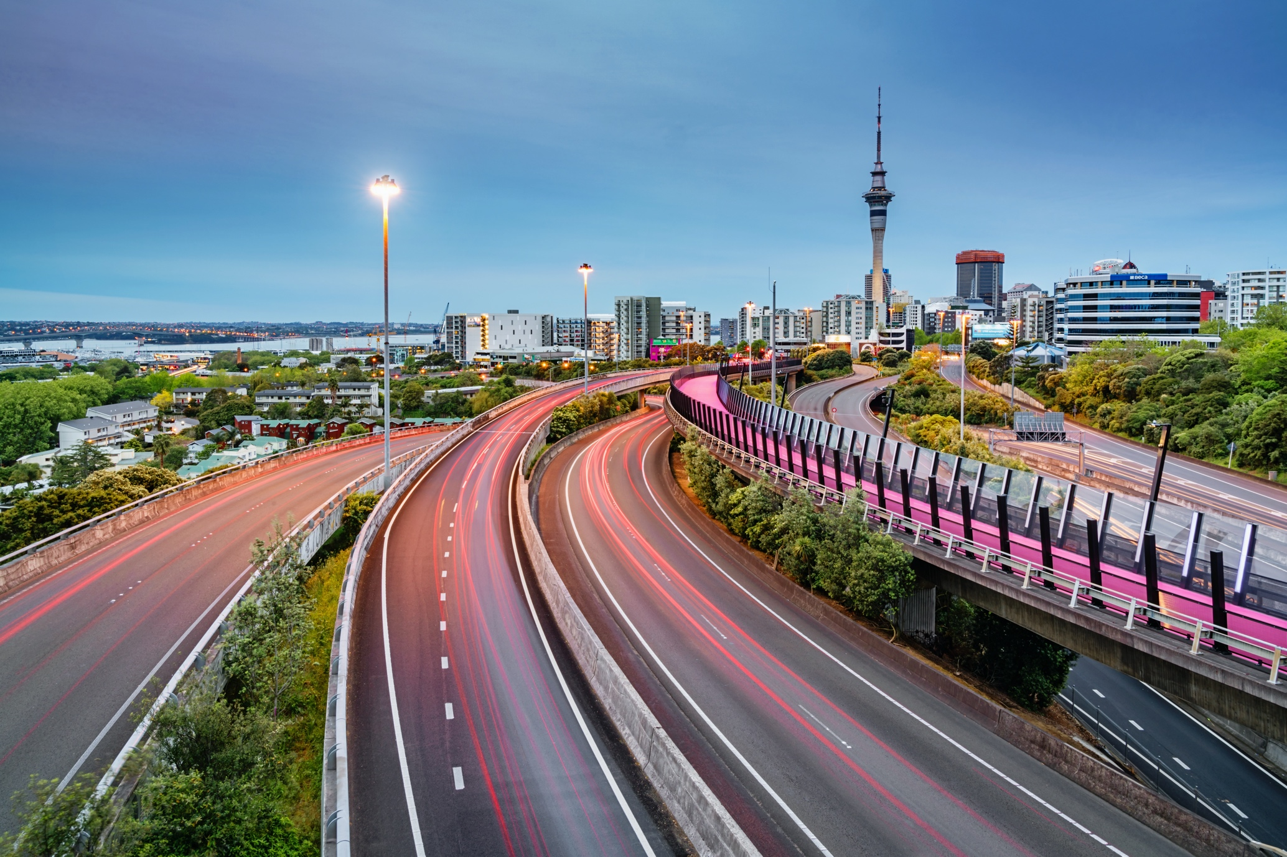
CITY EXAMPLES
33

Slide 34
EXAMPLES
34
Please find further city examples, included in the Example Annex, organised by section:
Governance & Structure
In Colombia, the cities of Medellin, Cali, Monteria and Pereira are working together with the National Ministry of Environment and the Hydrology, Meteorological and Environmental Studies Institute (IDEAM), with the support of C40 and WWF Colombia and the British Embassy (UK PACT program) to develop an MER system for current mobility projects. The project includes estimated GHG emission reductions, to be included in the National Registry for Colombian GHG reductions (RENARE), to support Nationally Determined Contributions (NDCs). More information will be available publicly here by the end of 2020.
Check the Knowledge Hub frequently for new examples
www.c40knowledgehub.org

Slide 35
EXAMPLES
35
Please find further city examples, included in the Example Annex, organised by section:
Define Indicators
Barcelona understands that the climate emergency requires everyone's effort and involvement. In 2015 the signatories to the More Sustainable Barcelona Network asked the City Council to provide a roadmap to face the climate crisis. Hence, the origin of the Barcelona Commitment to Climate, where the Network's organizations and the City Council set different targets and initiatives, including the drafting of the Climate Plan. The drafting of the Plan took into account the public's contributions, as well as the Climate Emergency Declaration, where many different sectors were involved. Both the Commitment and the Plan have included projects co-produced by citizen organizations and groups with the municipal support of human and financial resources. The Action Plan and the Climate Emergency Declaration are monitored every 6 months. You can find further information here.
The Pittsburgh Division of Sustainability and Resilience in the Department of City Planning developed the Pittsburgh Equity Indicators to measure progress against key objectives in the OnePGH Resilience Strategy tracking impacts across the City’s diverse population. The Equity Indicators represent the first step in the City’s larger effort to measure and track progress on resilience and wellbeing, inform current and future planning efforts, and support better communication and engagement with city residents.
www.c40knowledgehub.org

Slide 36
EXAMPLES
36
Define Indicators
Paris has created new forums for all Parisians to participate in climate actions. For instance, in 2018, Paris created a new governance of its Climate Action Plan called "Agora" gathering citizens, companies, NGOs and administration. The Agora exams Climate Action progresses published every year in Bleu Climat. Tackling energy poverty is one of the main priorities. Paris aims to reduce the estimated 77,000 households who suffer from fuel poverty, with subsidies retrofits, and better home energy management. Reducing fuel poverty will help low income communities and improve access to more affordable energy and energy efficient homes.
Monitoring systems and participation platforms – The city of Rio de Janeiro developed the Rio Painel, an integrated dashboard of spatial data to monitor indicators of territorial, socio-economic and governance dynamics in real time, as part of the City’s sustainable Development Plan. The Participa.Rio platform was developed to invite people to be a part of the city’s sustainable and climate action planning processes. Information will be publicly available at the end of 2020.
www.c40knowledgehub.org

Slide 37
EXAMPLES
37
Define Indicators
In April 2020, the City of Amsterdam became the first municipality in the world to publish a 'City Doughnut' - a strategic framework and policy – making tool based on the economic "Doughnut model", and a vision to emerge from the COVID-19 crisis as a city that ensures a good life for everyone, within the Earth’s natural boundaries. Released alongside the Circular Strategy, the Amsterdam City Doughnut is a tool to drive transformative action. The vision is to transition Amsterdam into a circular city, adopting a smarter approach to managing scarce raw materials, production and consumption, and creating more jobs for everyone. The approach applies 4 lenses: local, global, social and ecological to help city stakeholders to explore interdependencies between them. The aim is to foster co-creation of ideas, collaboration, community-led action, and local outcomes and benefits.
Check the Knowledge Hub frequently for new examples
www.c40knowledgehub.org

Slide 38
EXAMPLES
38
Please find further city examples, included in the Example Annex, organised by section:
Monitoring
The Strategy for a fossil-fuel free Stockholm by 2040 set key targets by calculating and analysing climate emissions. Stockholm focuses on the long-term goal and continually renews its analyses of potential emissions reductions. The instrument that governs this is the Environment Programme, revised every four years with targets to reduce tCO2 per capita from 2.3 in 2019 to 0.4 in 2039.
The Kampala Climate Change Action strategy highlights that severe climate change shocks and stresses such as flooding and heatwaves will impact on the livelihoods of the vulnerable urban poor in particular. City-wide climate risk mapping has provided a basis for integrated landscape policy and assessing community risk with the aim to mitigate these risks.
Check the Knowledge Hub frequently for new examples
Barcelona aims to reduce GHG emissions by 50% in 2030, compared to 1992 levels. To monitor progress, the city updates the GHG inventory annually, presenting results since the year 1992.
www.c40knowledgehub.org

Slide 39
EXAMPLES
39
Please find further city examples, included in the Example Annex, organised by section:
Monitoring
Starting in 2019 and following a rapid increase in the public offer of dock-less scooters and bikes, Mexico City started to define an efficient and comprehensive urban mobility policy based on improved data analysis.
The city required participating companies to provide the city with access to data in real time. This included all units and weekly data of system operations including trips, routes, time, etc.
The City of Rio de Janeiro developed a pioneering initiative based on the ILO (International Labour Organization) guidelines. It found that 9% of jobs in the city are considered ‘green’ and that 76 activities out of the total 675 in the national classification codes were identified as ‘green’. Read more here.
Los Angeles’ Green New Deal plans to transform the building stock, transportation network, electricity grid, and waste management of the city. This is expected to create and support 300,000 green jobs by 2035 and 400,000 by 2050. Targets include increasing private sector green investment to USD 750 million by 2025 and to USD 2 billion by 2035.
www.c40knowledgehub.org

Slide 40
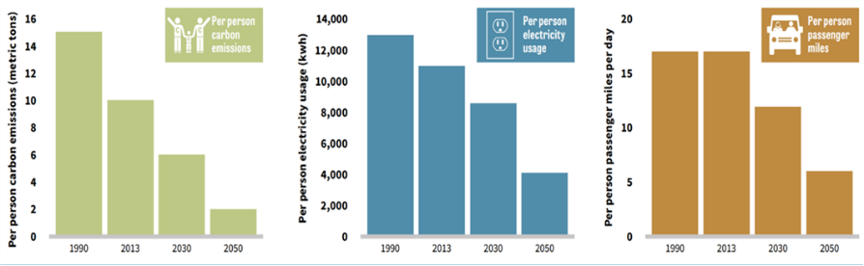
EXAMPLES
40
Please find further city examples, included in the Example Annex, organised by section:
Evaluation
Portland and Multnomah County Climate Action Plan scenarios includes per person carbon emissions, electricity use and passenger miles in 2030 and 2050. You can find further information in Portland´s Climate Action Plan.
Check the Knowledge Hub frequently for new examples
Portland and Multnomah County Climate Action Plan scenarios: per person carbon emissions, electricity use and passenger miles in 2030 and 2050. (Source: Portland Bureau of Planning and Sustainability)
www.c40knowledgehub.org

Slide 41
EXAMPLES
41
Please find further city examples, included in the Example Annex, organised by section:
Reporting
Durban plans to produce a “State of Climate Change Report” every two years, which will inform the update of the Climate Action Plan every five years. Durban will review:
Strategy and Direction: to adjust progress on current actions, and to take account of technological, scientific and ambition changes;
Learning and Communication: so that relevant sectors have the necessary skills and resources.
Governance and Management: mainstreaming monitoring and evaluation, defining timelines and responsibilities and requiring departments to submit data. The Governance plan aims to engage community stakeholders - an important part of monitoring.
You can find further information in Durban’s Climate Action Plan.
Check the Knowledge Hub frequently for new examples (new CAPs)
www.c40knowledgehub.org

