Slide 1

MONITORING, EVALUATION AND REPORTING (MER) FOR CLIMATE ACTION PLANNING
Workshop Material
Supported by:

Slide 2

WHAT YOU WILL FIND IN THESE SLIDES (1/2)
2
Facilitators will find recommendations and suggestions within this slide deck in these ‘dialogue boxes’. Make sure to remove them before the meetings
These resources were prepared to support initial conversations/meetings with city officials, to understand and assess a city’s current monitoring system, to identify gaps (if any) and opportunities to strengthen current processes and to identify current & new indicators. Materials include a proposed agenda, aims and templates for facilitating dynamic workshop sessions, including proposed group activities.
This slide deck includes the following content:
Pre-workshop meeting: proposed list of steps that could be undertaken prior to the workshops/meetings;
1st workshop: Initial screening, to understand the city’s current Monitoring, Evaluation and Reporting (MER) system;
2nd workshop: Indicator selection, to understand the “result chain” process, identify current and ‘potentially’ missing indicators, identify wider benefits and to have an overview on the reporting process;
www.c40knowledgehub.org

Slide 3

WHAT YOU WILL FIND IN THESE SLIDES (2/2)
3
Materials include proposed slides for the two introductory workshop sessions, which facilitators can tailor to their context and needs.
Cover slides include placeholder images, please tailor by inserting your own city pictures.
At the end of the slide deck there is a set of slides for facilitators, to support the preparation of the workshops, the delivery of proposed activities and a list of referenced sources.
Please refer to the CAP MER Summary & Introduction slide deck where you will find a set of slides to support initial conversations with the city, providing a step-by-step guide for developing a CITY CAP MER system, as well as useful examples of how cities have included MER in their published CAP, aligning the city’s vision and strategic pillars.
www.c40knowledgehub.org

Slide 4
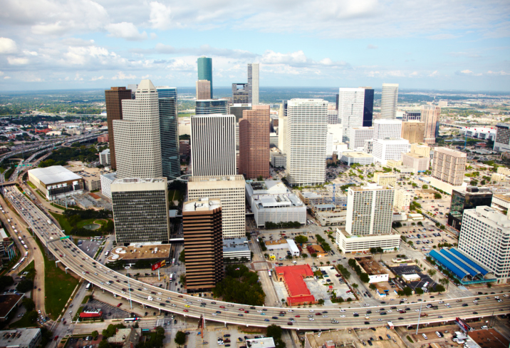
CONTENTS
4
Pre-Workshop Meeting
1st Workshop: Initial Screening
Overview;
Proposed Overall Agenda;
Initial Screening Sessions;
3) 2nd Workshop: Indicator’s Selection
Overview;
Proposed Overall Agenda;
Indicator’s Selection Sessions;
www.c40knowledgehub.org

Slide 5
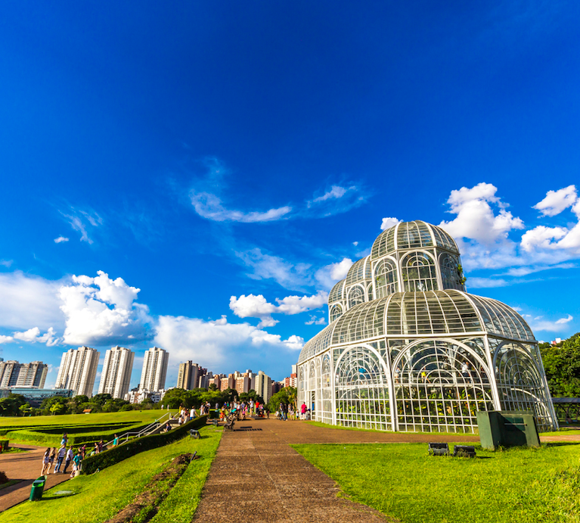
Pre- workshop meeting
5

Slide 6
Pre-workshop meeting
6
The following are proposed activities to conduct before the workshop:
Organise an initial meeting between the city advisor and the city CAP core team to:
Understand what is needed
Identify key departments that need to be involved in the "MER core team"
Suggestion: check CAP MER Summary and Introduction slide deck and the complete CAP MER resources in the resource centre.
Conduct a meeting with the ‘city monitoring core team’ previously identified:
Give a brief presentation of the CAP process and CAP framework requirements
Define where in the CAP process the city would like to focus on the MER discussion
Assess the city's current MER system
Define who will lead the MER process and if a wider group needs to be involved
Discuss the approach for the following meetings (who will coordinate/ lead the sessions, who needs to be involved, who will be presenting, what virtual platforms could be used, among other issues)
Suggestion: check workshop 1 and 2 materials for proposed ideas for a wider team meeting. Make sure you check the proposed activities in advance, in case they need prior preparation.
www.c40knowledgehub.org

Slide 7

7
1st Workshop: Initial Screening

Slide 8
Initial Screening: Overview
Users need to tailor the list of participants to their context
8
Suggested information sources
Purpose of the workshop
Proposed agenda
Proposed list of participants
MER Guidance & Example Annex
CAP MER Summary & Introduction
MER Indicator Matrix User Guide
Climate Action Planning Integrated Process (“Rainbow Chart”)
CAP Framework
Introduction and general overview of the city CAP process
MER Governance
Current monitoring system
Gap analysis
Feedback & Conclusion
City advisor/CAP core team manager
CAP focal team/climate change sustainability department
Technical departments/ sectoral teams/data providers
Mayor's office/ Planning departments
The aim of this workshop is to understand the city’s current monitoring system, how the CAP monitoring can fit in the current system and identify any potential gaps.
www.c40knowledgehub.org

Slide 9
Initial Screening: Proposed Overall Agenda
9
# | Session’s name | Session’s focus | Time | Lead
1 | Introduction and general overview of the CAP process | Workshop’s overview; create a common understanding of the CAP stages and where the city currently stands in the process | 50 minutes | City advisor/CAP core team manager + presentation
2 | MER governance | Components of an MER structure: coordination & stakeholders involved | 35 minutes | City advisor/CAP core team manager + Short presentation + individual activity
Coffee Break
3 | Current monitoring system | Underline the city’s current process | 40 minutes | CAP core team manager + plenary activity
4 | GAP analysis | Identify any potential gaps | 35 minutes | Plenary activity
5 | Feedback & Conclusion | Collect feedback and introduce the aim of the new workshop | 20 minutes | Facilitators + City Advisor/CAP core team manager
Note: total time 3 hours, without considering the break. Please tailor the agenda to the specific needs, and make sure the time allocated is enough for the aim of the sessions/activities and the number of participants.
www.c40knowledgehub.org

Slide 10
1st Session: Introduction and general overview of the CAP process
10
Aims: To introduce the workshop, to explain how it is structured, to create a common understanding of the CAP stages and to underline where the city stands in the process.
Content:
Introduction: structure of the workshop, session’s content, activities and goals (10 minutes)
Introduction of the CAP process: Climate Action Plan aligned with the objectives of the Paris Agreement, CAP framework criteria (10 minutes)
Explain CAP stages (‘rainbow chart’) and where the city currently is in the process. Highlight main deliverables and milestones. Present immediate next steps (10 minutes)
Introduction of the MER: concepts, framework criteria and main benefits (15 minutes)
Q&A (5 minutes)
www.c40knowledgehub.org

Slide 11
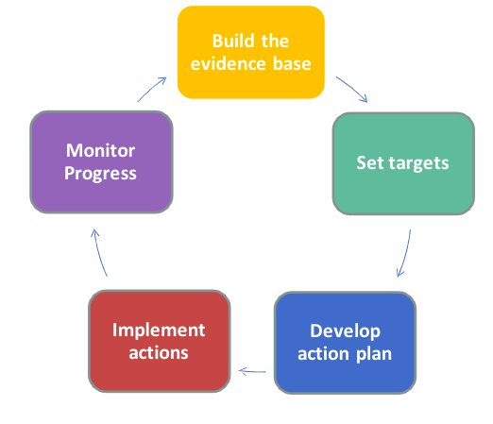
What is an MER system & why important?
Please find a few proposed slides that could be used to set the context. For further information, check the City CAP MER Guidance and the CAP MER Summary & Introduction slide deck
11
The objective of the Climate Action Plan (CAP) is to set a pathway to a carbon neutral, resilient and inclusive city. The content of the CAP is a set of targets, with strategies and prioritised actions to focus on achieving those targets​. It’s an iterative process, where steps are repeated with the aim of achieving continuous improvement (see circular diagram)
A Monitoring, Evaluation and Reporting (MER) system enables cities to decide what is important to measure, how to measure it and how to assess the real progress against the CAP targets, demonstrating the value of the actions taken. It also allows cities to show short-term progress, as reaching the final targets may take a considerable amount of time.
www.c40knowledgehub.org

Slide 12


CAP Framework Criteria
12
PLAN COMPILATION
3.4 MONITORING, EVALUATION, REPORTING AND REVISION
In line with the CAP Framework criteria, cities should develop a Monitoring, Evaluation and Reporting system as part of the Plan Compilation section of their Climate Action Plan.
Long-term commitment to delivering the plan should be demonstrated through a process of setting key performance indicators, ongoing monitoring, impact evaluation and progress reporting. This will provide stakeholders with transparency about the process, inspiring trust in the city government and its commitment to becoming an emissions neutral and climate resilient city by 2050. The plan should set out a method for monitoring, evaluation, reporting and revision.
www.c40knowledgehub.org

Slide 13
Benefits of an MER system
13
In order to measure success and adjust priorities over time, cities are looking to develop a well-structured system to monitor, evaluate and report progress. This is essential for monitoring the effects of climate actions across a diverse range of stakeholders.
1
SHARING
Provide relevant information to a wide range of stakeholders
2
GROWING
Continue to make the case for other possible climate actions
A CAP MER system enables cities to track and review the intended results and real progress, which could lead to greater access to national and international climate funding and secure more support from key stakeholder groups.
3
PERFORMING Assess progress and effectiveness and adapt actions and plans accordingly
4
COMMUNICATING
Improve transparency and accountability
www.c40knowledgehub.org

Slide 14
2nd Session: MER governance
14
Aim: To explain the components of an MER system with a focus on coordination and stakeholders engagement.
Content:
Brief introduction: Components of an MER structure: Governance coordination and Stakeholders engagement (15 minutes)
Individual activity (20 minutes)
www.c40knowledgehub.org

Slide 15
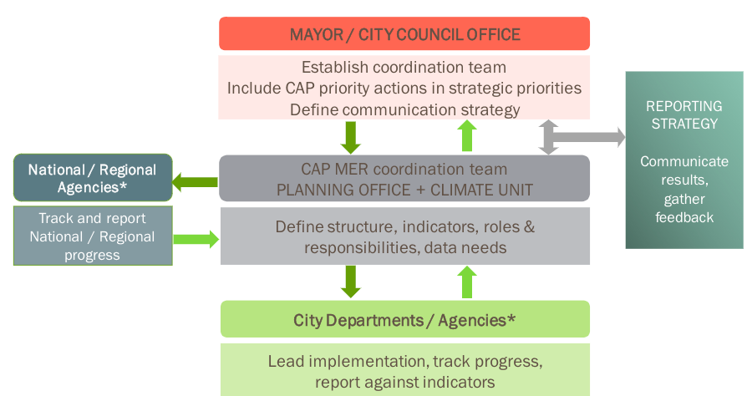
15
Define MER governance & structure
Consider presenting a concrete example from a city in your region, if available.
Defining the governance and structure for the city CAP MER system is a crucial point, ensuring the MER system is fully integrated into climate action planning and implementation.
Define the objectives of the system;
Identify key actors;
Establish a structure/governance of the system: roles and responsibilities;
Define a communication and reporting strategy;
Involving external actors from the beginning of the process is equally important.
www.c40knowledgehub.org

Slide 16
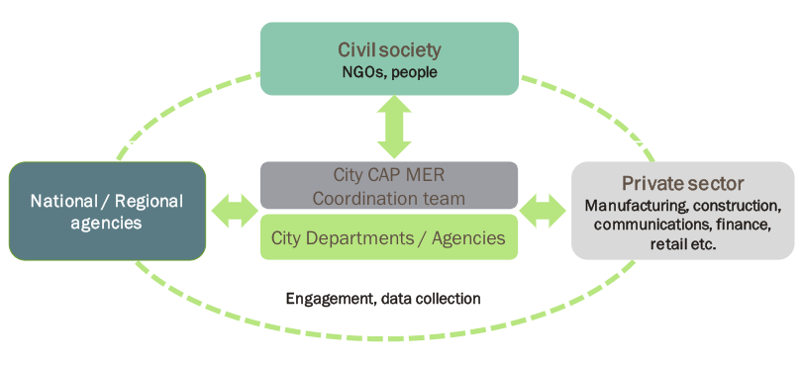
16
Stakeholder engagement
Consider presenting a concrete example from a city in your region, if available.
The choice to improve transparency and the ability to quantify the benefits of climate actions can secure support from key stakeholders.
The development of the MER system involves city departments, regional and national policy makers as well as other actors outside the coordination team.
The involvement of external stakeholders can help ensure:
The information reported is highly relevant to stakeholders’ needs;
The best available indicator data is collected and resources for collecting new data are planned;
Stakeholders agree with the monitoring process and commit to delivering data.
www.c40knowledgehub.org

Slide 17
MER governance activity
You can find blank diagrams in the “for facilitator” section
17
Aim: To have an overview of the current stakeholders, to identify potential new ones and how the stakeholders interact with each other.
Individual activity (20 minutes):
Think about the current stakeholders you interact with. Write them down on a post-it note/card. Please use 1 card for each stakeholder. Use different colours to identify them by ‘type’: in city department, private sector, NGO, national/regional government, etc.
Identify potential new stakeholders you think need to be involved too. Use 1 post-it note/card for each new stakeholder (using the previous colour code by type)
Use a different shape of card to identify whether a stakeholder is “old” or ”new”
Use the blank ’stakeholder map’ and paste your cards
Think about the way you currently interact with them and show it on the map (you can use arrows)
www.c40knowledgehub.org

Slide 18

Coffee break
18

Slide 19
3rd Session: Current monitoring system
19
Aim: To understand the current city’s Monitoring, Evaluation and Reporting system.
Content:
Short presentation: explanation on how the monitoring system is currently working (in terms of actions, organization, meetings, etc.) (10 minutes)
Participants describe their role (at a department level) and responsibilities regarding the city’s current monitoring process in relation to the MER (15 minutes)
Plenary Activity (15 minutes)
www.c40knowledgehub.org

Slide 20
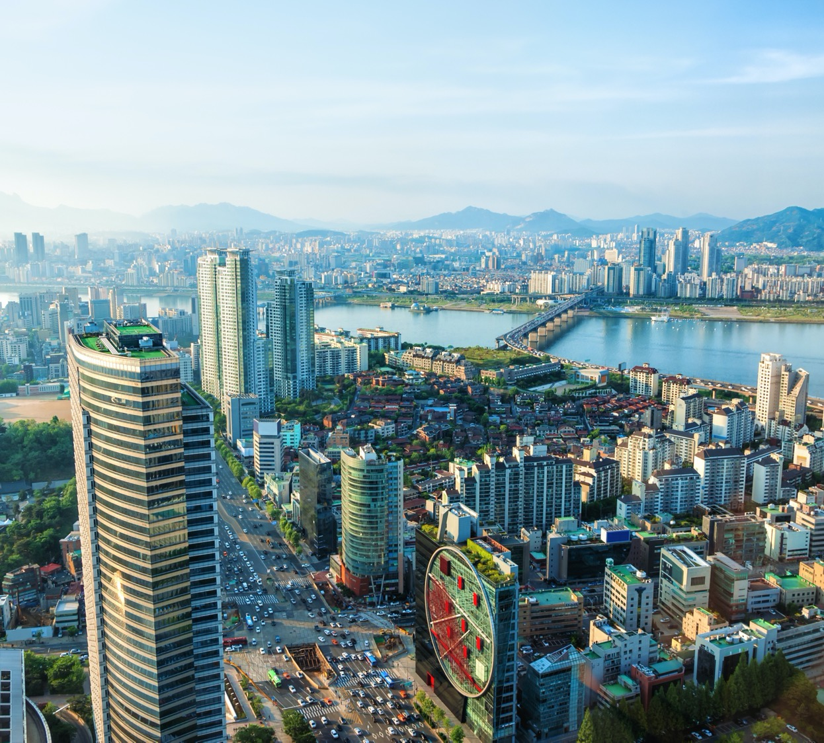
City Presentation
20
Use this placeholder to add slides to present your city’s MER structure and to introduce the activity.

Slide 21
Current monitoring system activity
21
Aim: To understand the current city’s Monitoring, Evaluation and Reporting system.
Plenary Activity (15 minutes):
Based on the content on slide 14, draw a diagram showing how the MER system is currently working in terms of timeline, role responsibilities, key stakeholders and governance
If there is not an MER system in place, try to understand the reasons (lack of data, organizational barriers, financial barriers, etc.)
The ideas can be written down on a card
Brief discussion on the results
www.c40knowledgehub.org

Slide 22
4th Session: GAP analysis
22
Aim: To identify any potential gaps in the current structure/process and prioritize actions related to the Monitoring, Evaluation and Reporting System.
Content:
Plenary Activity (35 minutes):
Think about the current structure and make proposals on how to improve it. Please write down the proposals and use a voting system to agree as a group. The proposals can be written on a board and a voting session can follow. Use pins to vote (maximum three pins per person)
Draw the new diagram with the proposals chosen during the voting by the participants
Brainstorming session to define how to integrate the current Monitoring, Evaluation and Reporting system. The ideas can be written down on a white board
Think about which actions related to the Monitoring, Evaluation and Reporting system need to be prioritised. Display the actions on a board
Divide the actions under different categories (e.g. data availability, organization, etc) and discuss who will need to lead on those actions. The ideas can be written down on a white board
Group discussion
www.c40knowledgehub.org

Slide 23
5th Session: Feedback & conclusion
23
Aim: To collect feedback and introduce the aim of the next workshop.
Content:
Wrap-up session: facilitators summarize group discussions and proposed ideas (10 minutes)
Conclusion of the session and short introduction on the next workshop (10 minutes)
www.c40knowledgehub.org

Slide 24

2nd Workshop: Indicator’s Selection
24

Slide 25
Indicator’s Selection: Overview
Users need to tailor the list of participants to their context
25
Suggested information sources
Purpose of the workshop
Proposed Agenda
List of participants
MER Guidance & Example Annex
MER Indicator Matrix User Guide
CAP MER Summary & Introduction
Toolkit for Equitable Impacts
Inclusive Climate Action Indicators Module & Database
Introduction and general overview
Current indicators & wider benefits
Identify indicators
GAP analysis
Group presentation
Reporting
Feedback & Conclusion
The aim of this workshop is to understand the ‘result chain’ process to define indicators, to identify current and missing city’s indicators, underline the potential wider benefits related to the prioritized actions and to have an initial overview of the reporting process.
City advisor/ CAP core team manager
CAP focal team/climate change & sustainability department
Technical department/data providers/ sectoral departments
www.c40knowledgehub.org

Slide 26
Indicator’s Selection: Proposed Overall Agenda
26
# | Session’s name | Session’s focus | Time | Lead
1 | Introduction and general overview | Workshop’s overview and goals; create a common understanding of the ‘technical’ concepts | 55 minutes | City advisor/CAP core team manager + group activity
2 | Current indicators and wider benefits | To get familiar with the city’s current indicators and to introduce the wider benefits | 45 minutes | City Advisor/CAP core team + sectoral representatives + presentation
Coffee Break
3 | Identify Indicators | To identify result chain indicators | 30 minutes | Group activity
4 | GAP analysis | To identify missing indicators | 25 minutes | Group activity
5 | Group presentation | To report back results of activities 1,3 and 4 to the wider team | 5 minutes each group (TBC depending on # of groups) | 1 speaker for each group
6 | Reporting | To underline the importance of reporting and have an overview of the current process | 45 minutes | Plenary activity
7 | Feedback & Conclusion | Collect feedback and conclusion of the workshop | 10 minutes | Facilitators + City Advisor/CAP core team manager
Note: total time 3:40 hours, without considering the break. Please tailor the agenda to the specific needs, and make sure the time allocated is enough for the aim of the sessions/activities and number of participants. Please check timing for session 5 and adjust accordingly.
www.c40knowledgehub.org

Slide 27
1st Session: Introduction and general overview
27
Aim: To introduce the workshop, to explain how it is structured and to create a basic and common understanding of the “technical” terms that might be used in the process of building indicators.
Content:
Brief recap of the previous workshop, underlying the goals achieved (5 minutes)
Introduction: structure of the workshop, sessions, contents, activities and goals (10 minutes)
Explanation and definition of the “technical” terms (20 minutes)
Q&A (5 minutes)
Group activity (15 minutes)
The session’s focus is on output, outcome and impact. Please feel free to check the CAP MER Indicator Matrix and Matrix User Guide to show a concrete example with indicators
www.c40knowledgehub.org

Slide 28

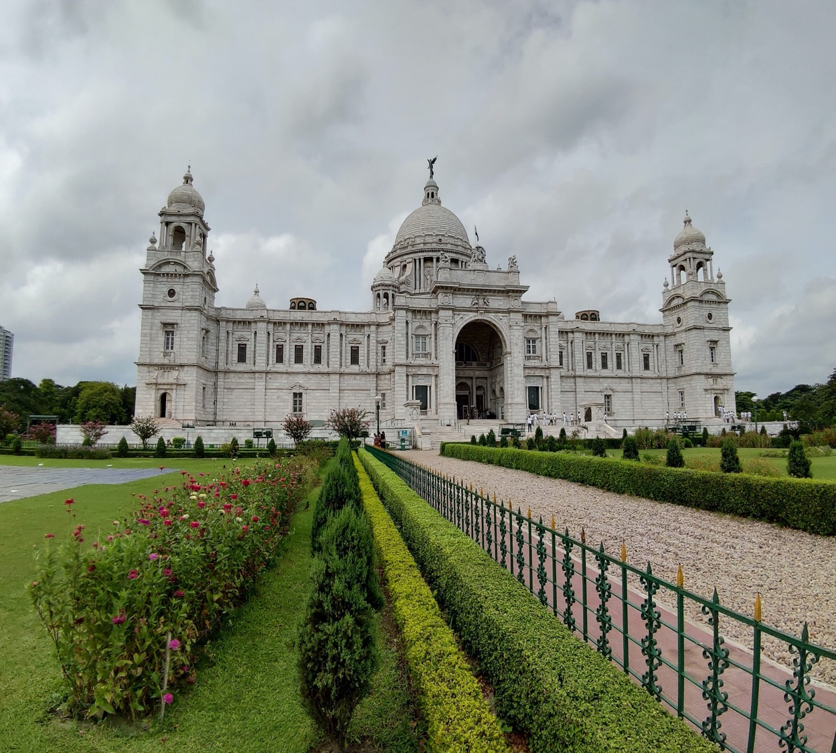
Recap 1st Workshop
28
Use this placeholder to add slides to recap briefly outcomes and discussions from the first workshop

Slide 29
Establish Intervention Logic: from action to impact
Please feel free to bring more examples from the matrix, considering the departments involved and the city’s priority actions
29
By measuring the whole chain of results, using logical steps, any risks of non-implementation can be identified early, and the assumptions made can be tested and revised.
Action: Any policy, program, project or activity initiated by urban public officials with the intention of contributing to climate resilience, carbon neutrality & inclusivity.
Milestones: major events, dates, decisions, or deliverables, usually in a project plan that might be used to monitor progress.
Output: Improvement from baseline, produced by the action.
Outcome: Change generated by the output. Not under direct control of the action intervention.
Impact: Effect of the outcome.
www.c40knowledgehub.org

Slide 30
Intervention logic activity
30
Aim: To understand/complete the result chain process.
Group activity (15 minutes):
Break people into groups
Select an action from the list (from the priority action list)
Each group needs to complete an example of an action’s logic “result chain”. Use the "blank intervention logic" table to facilitate the work
Make sure you choose someone to present the results at the end and you capture what you want to share
Priority Action | Output | Output Indicator | Outcome | Outcome Indicator | Impact | Impact Indicator
www.c40knowledgehub.org

Slide 31
2nd Session: Current Indicators and wider benefits
31
The session’s focus is on indicators. Please feel free to use the Matrix, User Guide, Inclusive Climate Action indicators module and database & C40 Climate Change Adaptation Monitoring, Evaluation and Reporting Framework
Aim: To understand the current city’s indicators and to introduce the wider benefits.
Content:
Brief recap of the city’s monitoring system, from the first workshop (3 minutes)
Overview of current indicators and process: what is the city currently measuring, how often, who is responsible, which sectors are involved? (12 minutes)
Two participants from two different departments explain their role and responsibilities (15 minutes)
Wider benefits introduction: Equity and Inclusivity (10 minutes)
Q&A (5 minutes)
www.c40knowledgehub.org

Slide 32
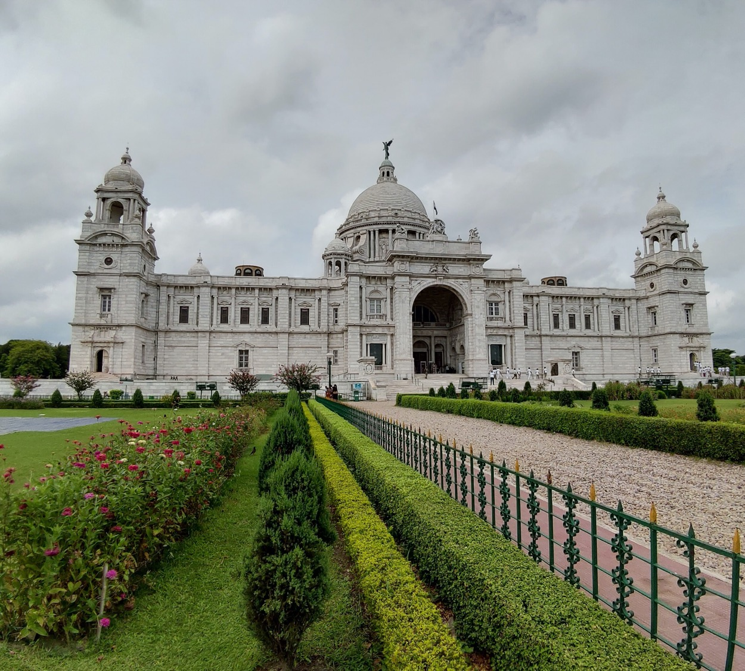
Recap city’s monitoring system
32
Use this placeholder to recap briefly the city’s monitoring system.

Slide 33
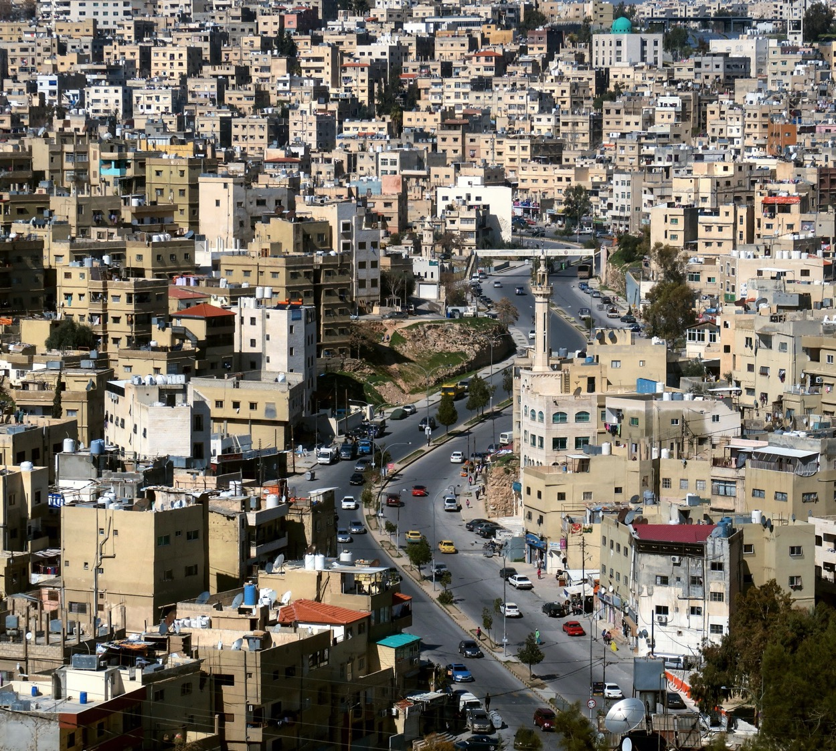
Overview of the current indicators
33
Use this placeholder to explain the current indicators. Make sure you address both adaptation and mitigation components.

Slide 34

Roles and responsibilities
34
Use this placeholder to underline roles and responsibilities of different participants. Make sure you agreed with the speakers before the workshop.

Slide 35
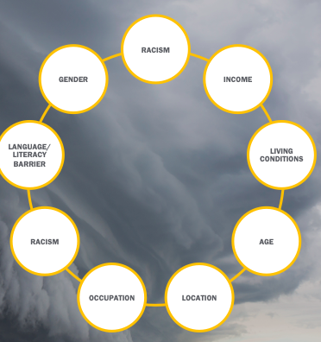
Equity & Inclusivity
35
Please find a few proposed slides that could be used to set the context. For further information, check the City CAP MER Guidance. Feel free to focus on your city’s priorities in terms of equity and inclusivity
The City’s Climate Action Planning MER should reflect the social, environmental and economic benefits expected from implementing the action included in the plan, as well as the distribution of those benefits across the population. Delivering on the Paris Agreement presents a unique opportunity to create a more just urban society, and it’s vital that cities monitor and track progress towards this ambition
Making the case for climate action is one of the main challenges facing cities and mayors; by monitoring, evaluating and reporting on the wider benefits – and who receives these benefits – city leadership can make a compelling case for climate action and build a broad base of support for enacting meaningful change.
Cities have to design climate actions in an inclusive way, such that the benefits are distributed equitably amongst the population, and thereby they must establish ways of monitoring and evaluating the distribution of benefits from different actions
It may be necessary to collect and analyse data disaggregated by group or community (income level, gender, ethnicity, ability status, etc.) to understand the various impacts of climate actions across the city’s population
Image’s source: Playbook for Inclusive Community Engagement (page 6)
www.C40knowledgehub.org

Slide 36
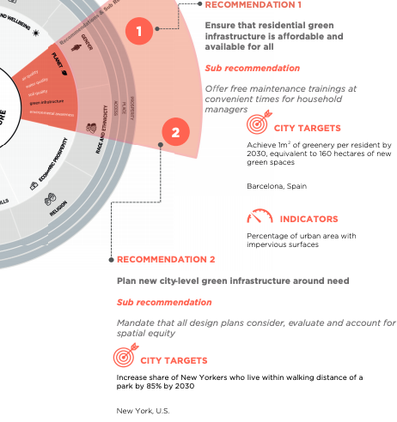
Equity & Inclusivity
36
The C40 Roadmap for Inclusive Planning outlines the importance of tracking the social, economic and environmental benefits of climate actions at the city and project level and includes a catalogue of policy-ready indicators, mapped to specific climate actions and the Sustainable Development Goals.
The Roadmap also includes action-specific indicators that cities can use to track its progress against key inclusivity and equity ambitions
Source: C40 Roadmap for Inclusive Planning (page 35)
www.c40knowledgehub.org

Slide 37
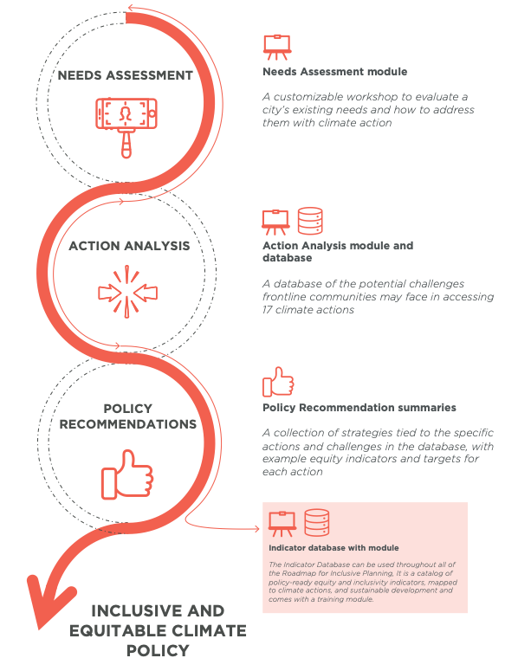
Equity & Inclusivity
Consider presenting a concrete example from your city or region, if available. Suggest adding a whole new slide with the example, before closing the session
37
Evaluating an action also provides an opportunity to assess its inclusivity by determining its impacts on different population groups.
In particular, the evaluation can assess the impact on disadvantaged or vulnerable people (the poor, elderly, etc.) who are previously identified in the needs assessments. It can help ensure equity of the climate action and that it does not have unintended negative impacts.
This way, the evaluation should aim to identify the extent to which the action has contributed to improving or worsening the situation of vulnerable populations.
Source: C40 Roadmap for Inclusive Planning (page 29)
www.c40knowledgehub.org

Slide 38
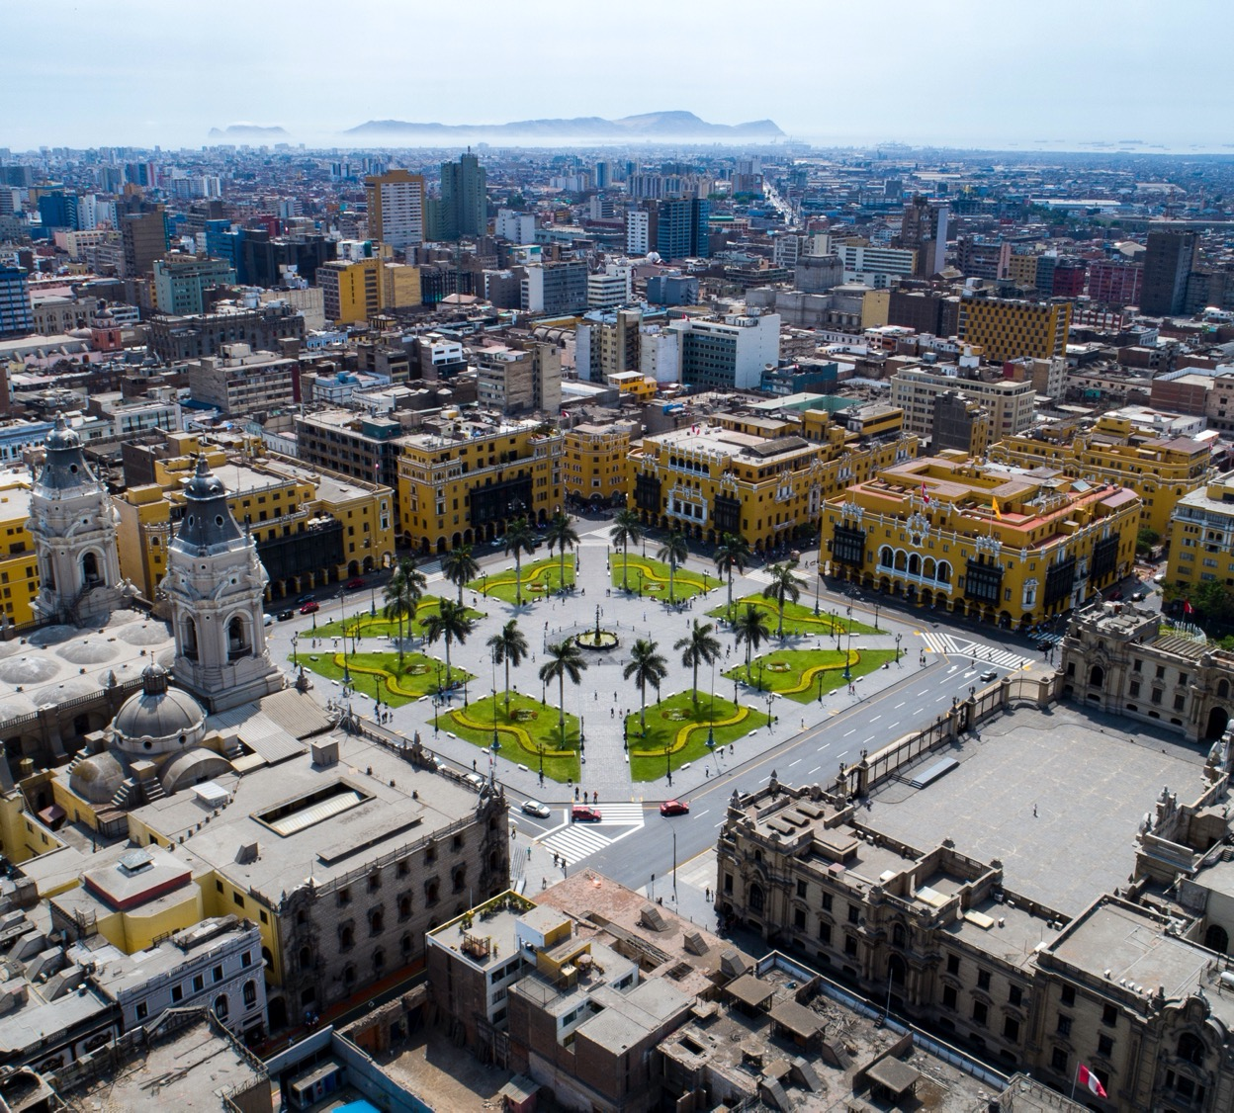
Coffee Break
38

Slide 39
3rd Session: Identify Indicators
39
Break into the same groups as the previous group activity. Take into consideration the result chain produced during the first session.
Aim: Identifying result indicators for the current priority. actions
Group activity (30 minutes):
Based on the results of the activity carried out during the first session, identify the indicators for each step of the intervention logic.
Participants write down indicators (one per post-it) and stick their post-it on the board/table.
At the end, each participant uses a “circle” post-it to categorize the indicators under the social, environmental and economical indicators.
Brief discussion on the results.
Make sure you choose someone to present the results at the end and you capture what you want to share.
Priority Action | Output | Output Indicator | Outcome | Outcome Indicator | Impact | Impact Indicator
www.resourcecentre.c40.org

Slide 40
4th Session: GAP analysis
40
Please feel free to print the list of current indicators and paste it on a board. If it is a virtual workshop share the list in advance through email. You can find it in City CAP MER Guidance
Aim: To define any possible missing indicators.
Content:
Group activity (25 minutes):
Based on the results of the previous exercise and the list of the city’s current indicators, use two different colours to distinguish between existing and missing indicators.
Group discussion to understand the challenges around the missing indicators. Write down your thoughts (including potential way to overcome those barriers/challenges).
Make sure you choose someone to present the results at the end and you capture what you want to share.
Go back to the plenary session.
www.c40knowledgehub.org

Slide 41
5th Session: Feedback from groups
41
Please check time allocation for this activity. Make sure you provide enough time for each group to present the results of the 3 exercises and have a plenary discussion. Once defined, make sure you tailor the agenda accordingly
Aim: To present the results of the group activities.
Content:
Speaker (5 minutes for each group –Total time TBC depending on the # of the groups)
The previously designated speaker presents the results of exercises 1, 3 and 4 for his/her group using the completed table.
www.c40knowledgehub.org

Slide 42
6th Session: Reporting
42
Please feel free to check the City CAP MER Guidance to get further information
Aim: To define guidelines in the reporting process and to have an overview of the current process.
Content:
Brief introduction: how the reporting process works, the main purpose and why it is important (10 minutes)
Explanation about reporting audiences, timelines and platform (10 minutes)
Plenary activity (25 minutes):
www.c40knowledgehub.org

Slide 43
Reporting process
43
Please feel free to use a reporting example from your city.
Make sure you draw the line with the outcomes of the ‘stakeholder mapping’ activity
Reporting means presenting the data and analysis, compiled during the monitoring, to stakeholders for information or knowledge-sharing
The purpose of the reporting can be different depending on the target audience.
Reporting can be pre-determined under a reporting plan detailing the structure and procedures. The plan should include in what format data should be reported, to whom, at what intervals and for what purpose.
The content or form of the reporting can vary. It can include reports on CAP implementation, regular (quarterly/biannual/annual) monitoring reports on results or live dashboard format for some components.
www.c40knowledgehub.org

Slide 44
Reporting timelines and platform
44
Please refer to the C40 Climate Change Adaptation Monitoring, Evaluation and Reporting Framework and the ‘Measuring progress section’ in the Adaptation Masterclass materials.
The real value of MER emerges over time, when targets have been tracked over a number of years. Performance may be measured against baselines or compared with ‘Business as Usual’ scenarios: the scenario for when no action is taken. It is therefore ideal to establish and maintain a robust data reporting plan, in order to maximise the benefits of keeping historical datasets.
The graphic below shows the typical communications needs of different stakeholders.
Reported information should include monitoring results. Tools and templates can be created to optimise the reporting process and structure its content. The format is then pre-defined for subsequent reports. Page 5 of the C40 City Climate Action Planning MER Indicator Matrix User Guide gives an example of such a reporting tool.
www.c40knowledgehub.org

Slide 45
Reporting timelines and platform (cont.)
45
The graphic below shows the typical communication needs of different stakeholders.
Political Leaders
Political Leaders
Political Leaders
Department Heads
Political Leaders
City Dwellers
Political Leaders
External Groups
What do they need?
e.g. development banks, funders
Potentially all levels: Outputs, Outcomes and Impacts
Progress on climate goals
Outcomes/Impacts
Progress on actions
Outputs
The effects of actions: Outcomes
Impact indicators
How is the risk reduced
Why do they need to know this?
Show political achievements
Make decisions, planning
Make the case for action
Resource allocation
Accountability
Reporting indicators
Awareness and education
Accountability
Reporting
Basis for applications
How would you communicate to them?
Executive summaries
Numbers
Graphs/ data
Numbers
Location
Benefits
Social media
Infographics
Numbers
Infographics
www.c40knowledgehub.org

Slide 46
Reporting activity
46
Use the “blank” reporting table. You can find it in the “for facilitator” slides
Aims: To identify and assess current reporting systems/audiences and communication platforms.
Plenary activity (25 minutes):
Think about the communication topics and current audiences in your city and write them on a post-it. Use 1 post-it for each topic and audience. To do this complete column number 1 and 2 of the table. Use different colours to distinguish between:
Internal: inside city government (horizontal integration)
External: sub national/national government/private sector/NGOs/citizens
International platforms/networks/institutions
Think about missing audiences and write them on a card (using another post it colour or shape). Paste the cards on column 3 of the table.
Think about who is responsible for the current communication with each audience and how the process works (platform and frequency). To do this complete respectively columns 4,5 and 6.
Discuss together the current approach and potential improvement opportunities
Communication topic | Audiences | Missing audiences | Responsible | Reporting platform | Reporting frequency

Slide 47
7th Session: Feedback and Conclusion
47
Aim: To collect feedback and conclude the workshop
Content:
City Advisor/facilitator concludes the session, briefly summarizes outcomes of the discussions and explains the next steps (10 minutes)
www.c40knowledgehub.org

Slide 48
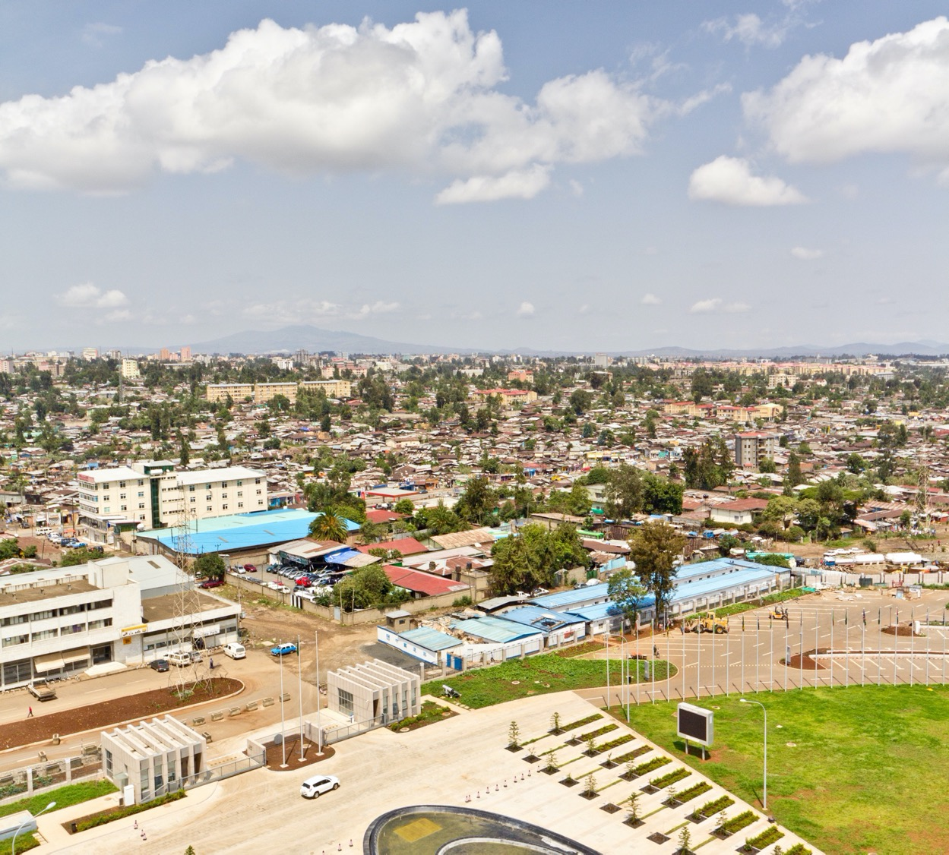
Facilitator slides
48

Slide 49
Workshop preparation
49
In preparation (or while preparing) for the meeting/workshop, please bear in mind:
What you will plan to do with the information you will collect during the session.
What information you are keen to collect (e.g. more technical data, roles and responsibilities overview, existing gaps…)
Which stakeholders or departments needs to be involved.
Think about the number of facilitators and groups for the workshop; keep in mind the number of people per group and the number of facilitators per group. It is recommended to have one person per sector for each group for some activities. For other activities a sectoral group would be better.
Suggest having pre-workshop meetings with facilitators and other presenters. Think about the purpose of the session and the preparation of slides (if needed).
www.c40knowledgehub.org

Slide 50
Workshop preparation
50
In preparation (or while preparing) for the meeting/workshop, please bear in mind:
Check the Glossary in the City CAP MER Guidance to have an overview of the “technical” terms needed during the first session of the 2nd workshop.
Be sure you use examples during the first session of the 2nd workshop for the intervention logic and technical terms. Check the matrix for more examples.
Make sure during the second session of the 2nd workshop to address both adaptation and mitigation.
If your city has already finished the action prioritisation stage it is recommended to bring a list of priority actions for the indicator’s session. Make sure you identify before the workshop and bring a list of current indicators and owners.
Please be sure that all participants have read the checklist in the guidance. For this, it is recommended to send the checklist by email to the participants before the workshop or print it and distribute the checklist to the participants during the session.
www.c40knowledgehub.org

Slide 51
Workshop preparation
51
In preparation (or while preparing) for the meeting/workshop, please bear in mind:
Consider the results of the needs assessment (if you want you can bring a summary, the co-benefit criteria used for the Action Section & Prioritisation (ASAP) process; think about thematic areas that are related to the equity and inclusivity component (e.g. health, gender, jobs, access to the benefit…) to use during one of the activities.
Please check examples from other cities in term of equity & inclusivity.
Please feel free to create and add slides from the need assessment to the equity and inclusivity session.
It is recommended to organise another meeting where you could follow the steps suggested during this workshop and replicate them in all the priority actions and list all the missing indicators. Participants can choose three priority actions, analyze them at home, following the same process proposed during the workshop, and present them to the plenary group.
During the 6th session of the 2nd workshop make sure to draw the line with the stakeholders identified in the previous activities.
www.c40knowledgehub.org

Slide 52
52
“Blank” stakeholders map
Please feel free to print and use this diagram during the MER governance activity
Civil society
City CAP MER
Coordination team
Private sector
www.c40knowledgehub.org

Slide 53
“Blank” MER governance & structure
53
Please feel free to print and use this diagram during the Current Monitoring System activity
MAYOR / CITY COUNCIL OFFICE
REPORTING STRATEGY
National / Regional Agencies
CAP MER coordination team
PLANNING OFFICE + CLIMATE UNIT
Departments / Agencies
www.c40knowledgehub.org

Slide 54
“Blank” Intervention logic table
Feel free to print or replicate this template for a virtual facilitation, to use it during the “result chain” activity and to tailor it based on your needs.
54
Priority Action | Output | Output Indicator | Outcome | Outcome Indicator | Impact | Impact Indicator
www.c40knowledgehub.org

Slide 55
“Blank” Reporting table
55
Feel free to print or replicate this template for a virtual facilitation and to use it during the reporting activity
Communication topic | Audiences | Missing audiences | Responsible | Reporting platform | Reporting frequency
www.c40knowledgehub.org

Slide 56
Considerations to define the list of participants
56
Slides 7 and 24 presents a proposed list of key departments that could be invited to the workshop/meetings. This will depend of course on each city’s context. Below you will find a few suggestions to take into consideration while putting together the list of participants:
Which stage of the process the city is currently undertaking, and which departments have already been involved and are familiar with the CAP process.
What type of information you would like to collect from each participant/department.
Think about the role and ‘level of hierarchy’ that you think you need to involve from each department.
Consider inviting members of regional/national government, if useful.
Consider inviting a political focal point to guarantee engagement throughout the whole MER process.
Think about the reporting audiences. Do you need to invite the communication department too?
www.c40knowledgehub.org

Slide 57
Outcome
57
While delivering the workshop and activities, keep in mind the expected outcome of the sessions:
Clear understanding of departments involved; roles & responsibilities.
Clear understanding of the current monitoring structure in the city.
Current available data.
Identification of data gaps and potential weaknesses in the current structure.
Which stakeholders are involved and which ones need to be added to the process.
www.c40knowledgehub.org

Slide 58
Virtual Workshop (for facilitators)
58
If you are having a virtual meeting, please consider the following:
Please make sure you know how to use the online software and test them in advance.
Some software proposals for the virtual workshop: Mural (for activities), Zoom (to create breakout rooms and groups), Mentimeter (to vote). Please feel free to use any other software.
It is recommended to have the material (templates, etc.,) ready before the workshop.
Please make sure you test the virtual activities in advance.
If you are having a virtual meeting some proposed activities can be modified to adapt them to the virtual form:
When it is recommended to divide people into groups, it is possible to do this either by pre-assigning participants to each breakout room (recommended choice) or by assigning participants randomly.
www.c40knowledgehub.org

Slide 59
References
59
City CAP MER Guidance
City CAP MER matrix User Guide
CAP MER Indicator Matrix
C40 Roadmap for Inclusive Planning
Playbook for Inclusive Community Engagement
C40 Toolkit for Equitable Impacts
Inclusive Climate Action Indicators module and database
C40 Climate Change Adaptation Monitoring, Evaluation and Reporting Framework
CAP Framework Criteria
www.c40knowledgehub.org

